Slide 1
AIR QUALITY INDEX OF INDIA
DATA ANALYSIS AND VISUALIZATION Project on:
“Comprehensive Analysis of Air Quality in India on PM2.5 and AQI Patterns”
Presented by:
Misba Kousar
Batch no:PGDDM51

Slide 2
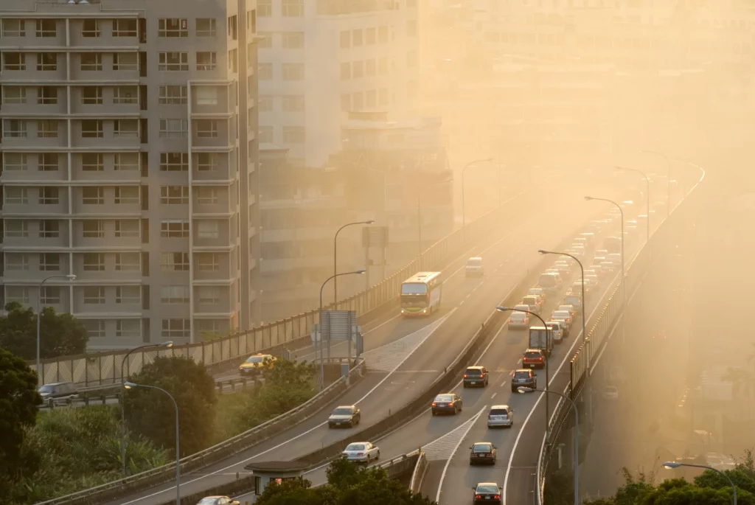
agenda
Objective
Dataset overview
Libraries used
Data cleaning and preprocessing
Insights from the project
Future scope
Conclusion

Slide 3
OBJECTIVE
The objective of this project is to conduct a comprehensive analysis of air quality in India by studying PM2.5 concentration trends, their relationship with AQI, city-wise pollution patterns, and the influence of meteorological factors, in order to assess air quality severity and support informed environmental decision-making.

Slide 4
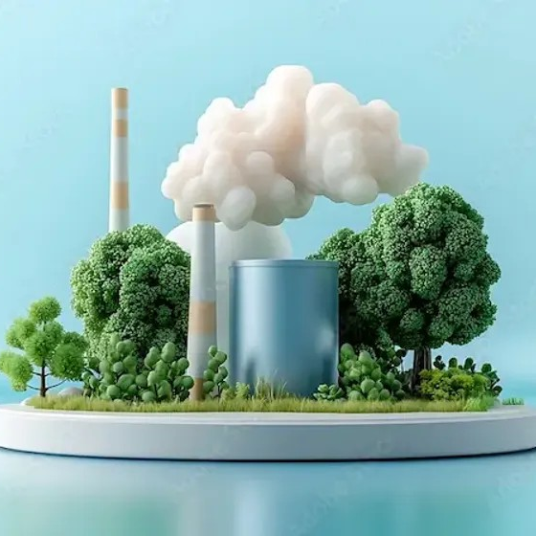
DATASET OVERVIEW
Identification & Time Columns
City – Name of the city where air quality and meteorological data were recorded.
State – Administrative state corresponding to each city, used for regional comparison.
Datetime – Exact date and time of each observation, enabling time-series analysis (Year,Month,Day, Hour, Day_of_week, Day_Name, Week_of_year, Is_weekend, Quarter,Time_of _Day,Season these are the columns that are derived from Datetime)

Slide 5
Meteorological & Weather Variables
Temp_2m_C | Air temperature measured at 2 meters above ground level, used to assess the influence of thermal conditions on air pollution.
Humidity_Percent | Relative humidity of the air expressed as a percentage, indicating moisture content that can affect pollutant formation and dispersion.
Humidity_Category | Categorical classification of humidity levels (e.g., low, moderate, high) for comparative and grouped analysis.
Wind_Speed_10m_kmh | Wind speed measured at 10 meters above ground in km/h, representing atmospheric ventilation and pollutant dispersion capacity.
Wind_Category | Categorized wind speed levels used to evaluate pollution behavior under different ventilation conditions.
Wind_Stagnation | Indicator of stagnant atmospheric conditions characterized by low wind speeds, which promote pollutant accumulation.
Is_Raining | Binary variable indicating whether rainfall occurred, enabling comparison between rainy and non-rainy periods.
Heavy_Rain | Binary indicator identifying heavy rainfall events, useful for assessing strong pollutant removal effects.

Slide 6
Air Pollution & Particulate Matter
PM2_5_ugm3 | Concentration of fine particulate matter (≤2.5 µm), a major health-relevant pollutant.
PM10_ugm3 | Concentration of coarse particulate matter (≤10 µm), contributing to overall air quality degradation.
PM_Ratio | Ratio of PM2.5 to PM10, indicating dominance of fine particles in total particulate pollution.
CO_ugm3 | Concentration of carbon monoxide (CO) in micrograms per cubic meter, indicating emissions from incomplete combustion sources such as vehicles and biomass burning.
NO2_ugm3 | Concentration of nitrogen dioxide (NO₂) in micrograms per cubic meter, primarily emitted from traffic and industrial activities and involved in secondary pollutant formation.
SO2_ugm3 | Concentration of sulfur dioxide (SO₂) in micrograms per cubic meter, mainly originating from fossil fuel combustion and industrial processes.
O3_ugm3 | Concentration of ground-level ozone (O₃) in micrograms per cubic meter, a secondary pollutant formed through photochemical reactions involving nitrogen oxides and sunlight.
Dust_ugm3 | Concentration of dust particles in micrograms per cubic meter, representing natural and resuspended particulate matter contributions to air pollution.

Slide 7
Air Quality Index (AQI) Metrics
US_AQI | Overall Air Quality Index calculated using US EPA standards.
US_AQI_PM25 | AQI sub-index derived specifically from PM2.5 concentrations.
US_AQI_PM10 | AQI sub-index derived from PM10 concentrations.
AQI_Category | Categorical classification of AQI levels (e.g., Good, Moderate, Poor).
PM25_Category_India | PM2.5 category based on Indian National Ambient Air Quality Standards.
WHO_Exceed | Binary indicator showing whether PM2.5 exceeds WHO recommended limits.

Slide 8
Event & Seasonal Activity Indicators
Festival_Period | Indicator identifying festival periods associated with short-term emission spikes.
Crop_Burning_Season | Indicator marking agricultural burning seasons linked to elevated particulate pollution.

Slide 9
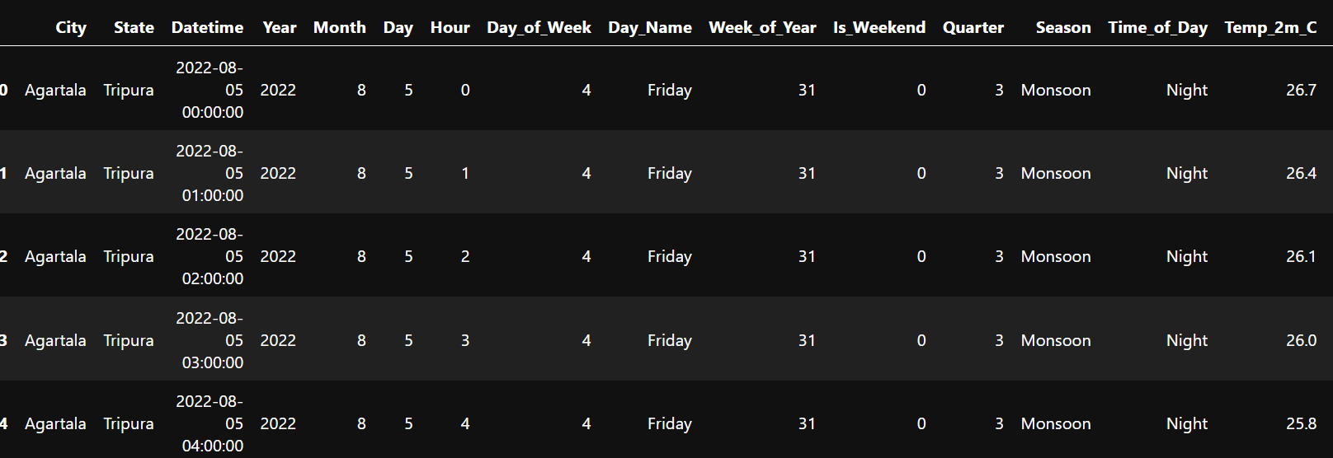
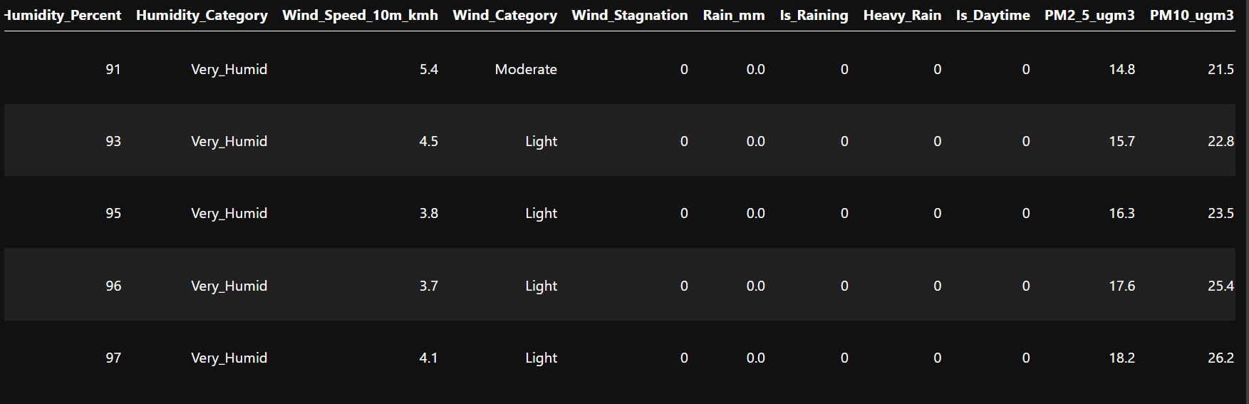
dataset

Slide 10
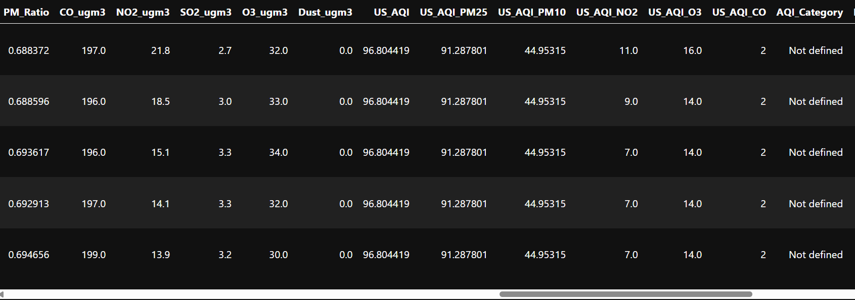

Slide 11
Libraries used:
NumPy (numpy) – A fundamental Python library for numerical computing, providing efficient array operations and mathematical functions used for data processing and calculations.
Pandas (pandas) – A powerful data manipulation and analysis library offering data structures such as DataFrames for cleaning, transforming, and analyzing structured datasets.
Matplotlib (matplotlib.pyplot) – A comprehensive plotting library used to create static, publication-quality visualizations for exploratory data analysis.
Seaborn (seaborn) – A high-level statistical visualization library built on Matplotlib, used to generate informative and aesthetically enhanced plots with minimal code.
Plotly Express (plotly.express) – An interactive visualization library that enables dynamic, web-based plots for deeper data exploration and improved user interaction.

Slide 12
Data Cleaning and Preprocessing
1. Handling missing values
Columns with more than 60% missing (null) values were removed from the dataset, as they lacked sufficient information to contribute meaningfully to the analysis.
For columns with less than 60% missing values:
  Numerical columns were imputed using the mean value, preserving overall data distribution while avoiding data loss.
  Categorical columns with two categories were filled with a new category labeled “not defined” to retain records without introducing bias.

Slide 13
2. Removing redundant and non-informative columns
One column containing only zero values across all records was identified and removed, as it provided no analytical value.
Additionally, columns that were not relevant to the project’s analytical objectives—such as unused spatial variables, alternative aqi systems, and unused meteorological parameters—were dropped to reduce dimensionality and improve clarity.
3. Final dataset optimization
After cleaning, the dataset contained only:
Relevant temporal, meteorological, and pollution-related variables
Columns directly supporting PM2.5, AQI, seasonal, risk-based, and event-driven analysis

Slide 14
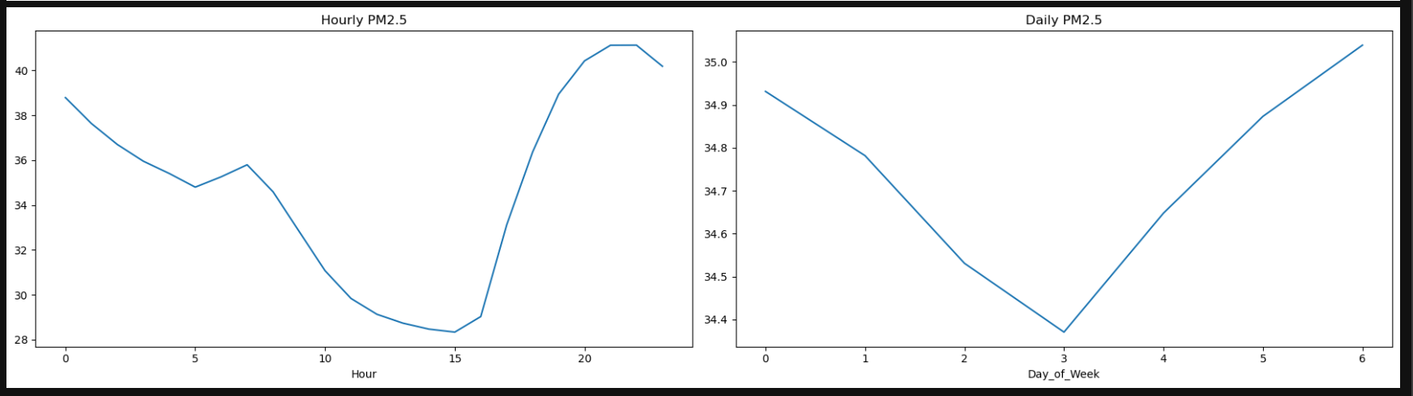
Graphs from the project

Slide 15
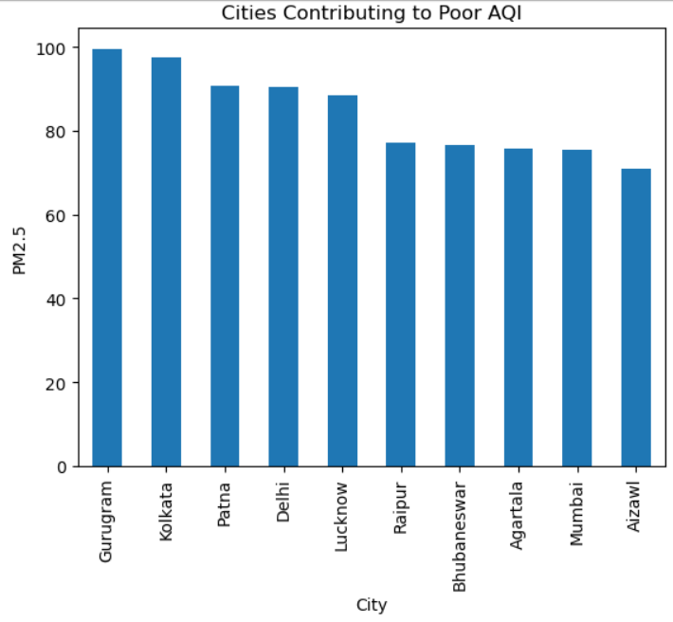
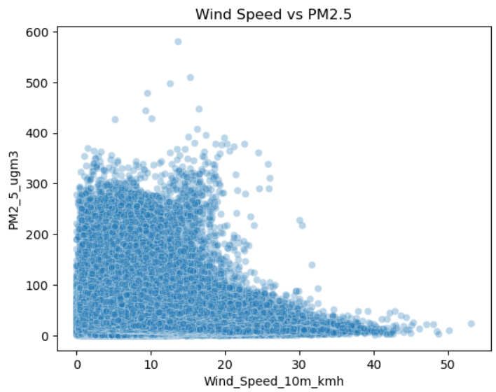

Slide 16
Overall Insights of the Whole Project
1. Pm2.5 temporal variation
Pm2.5 levels show clear hourly, daily, and seasonal patterns.
Higher concentrations are observed during winter months, likely due to temperature inversion and reduced dispersion.
Night-time and early morning hours often exhibit higher pm2.5 levels.
2. Cities with worst PM2.5 impact
Major metropolitan and industrial cities contribute the most to poor AQI levels.
Urbanization, traffic density, construction, and industrial activity are key drivers.
These cities repeatedly appear in the highest aqi and pm2.5 rankings.

Slide 17
3. Strongest pollutant predictor of AQI
Pm2.5 emerges as the strongest and most consistent predictor of AQI.
Other pollutants (pm10, no₂, so₂, co) influence aqi but with comparatively lower impact.
This confirms pm2.5 as the dominant pollutant shaping air quality in india.
4. Effect of wind speed on PM2.5
An inverse relationship is observed between wind speed and PM2.5 concentration.
Higher wind speeds help disperse pollutants, reducing pm2.5 accumulation.
Low wind conditions are associated with severe pollution episodes.

Slide 18
5. Who pm2.5 limit exceedance
A significant number of days exceed the who-recommended PM2.5 limit (15 µg/m³).
This indicates chronic air pollution and long-term health risks for the population.
Many regions remain above safe limits for most of the year.

Slide 19
Future scope
Health impact analysis
Predictive modeling
Source apportionment
Traffic density & mobility pattern analysis

Slide 20
CONCLUSION
This project provides a comprehensive and data-driven understanding of air quality in India, with PM2.5 identified as the most critical pollutant influencing AQI. The analysis highlights severe and persistent air pollution across major cities, strong seasonal patterns, and frequent violations of WHO safety limits. Meteorological factors such as wind speed play a significant role in pollutant dispersion. Overall, the findings emphasize the urgent need for targeted pollution control measures, predictive systems, and public health interventions to improve air quality and protect human health in india.

Slide 21

Thank you

